Slide 1
New Customs Acts Programme
Registration, Licensing and Accreditation –
Trade Awareness Session

Slide 2
Registration, Licensing and Accreditation (RLA)
Presentation Structure
 | Content | Slides
1 | Objective | 2
2 | What we are implementing and System Capabilities | 3-4
3 | RLA Trader Process Overview | 5
4 | RMM Process Overview | 6
5 | Pre-conditions for applying via the RLA system | 7
6 | Legal Entity Process and eFiling Registration | 8 - 11
7 | RLA Registration via eFiling | 12 – 30
8 | RLA Registration via BFE | 31 - 34
9 | Relationship Management | 35 - 39
10 | eFiling vs Branch Submission | 40 - 42
11 | Anticipated impact on Trade | 43 - 46
12 | Trade Support | 47 - 49

Slide 3
Objective
Registration, Licensing and Accreditation (RLA)
To inform Trade on the implementation of RLA Release 1;
  RLA will be released on the basis of the C&E Act 1964 and not on the basis of the new Customs Control Act (CCA);
  The programme is planned to be rolled out to Trade in September 2019, pending the successful completion of the RLA pilot;
  Customs Sufficient Knowledge will not be part of the RLA roll out.

Slide 4




What are we implementing?
Registration, Licensing and Accreditation (RLA)
RLA Full Production Release
September 2019
Alberton
stabilise
Cape Town
stabilise
Durban
stabilise
Pretoria (CBD)
stabilise
OR Tambo
Fiksburg Bridge
Lebombo
Oshoek
Nakop
Open port by port for Branch Capture
stabilise
stabilise
Extend to remaining Customs branches
Sep - Oct 2019
Oct – Nov 2019
Customs Office
Maseru Bridge;Port Elizabeth
Groblersbridge;Bloemfontein;
Beitbridge;Kopfontein;
Pietermaritzburg;
Stellenbosch;Qacha’s Nek;
Van Rooyenshek;
East London;Nelspruit
Kimberley;Mahamba
Worcester;Richards Bay;
Ramatlabama;Paarl;
Oudtshoorn;Caledonspoort;
Skilpadshek;Vredendal;
Robertson;Lanseria;
Jeppes Reef;Polokwane;
Golela;Mossel Bay;Vioolsdrift;
Mananga;Mmabatho;Nerston;
Pilanesberg;Port Elizabeth;
Saldanha Bay;Upington
SCOPE Inclusions:
  Customs Trader Portal (CTP);
  Relationship Management (RMM);
  New applications, amendments and withdrawals;
  Workflow and Case Management;
Customs Operations Portal (COP) for Branch Front End (BFE) – branch capture and branch scanning;
Reporting
SCOPE Exclusions:
Rebate users, warehouses, premises, terminals, depots, EDI, deferments, accreditation, associations and selected reporter applications - continue with existing DA185/RAS process:
Stop RAS registrations for new selected client types

Slide 5
Registration, Licensing and Accreditation (RLA)
System Capabilities
The system is a web-based electronic channel; registrations are initiated from eFiling or BFE submission channel;
Electronically captured applications and supporting documents are uploaded to the application – no paper documents;
System validations have been configured to improve accuracy of data submitted;
The application form is intuitive, based on the client type selected and information captured in the application;
A pre-pop selection capability to enable the re-use of previously submitted information e.g. address or contact details;
Automated notifications are introduced for selected correspondence in the first release (approval; rejection and associated certificate/license) and thereafter incrementally released;
A dashboard will be available to clients to view their registration profile and initiate new actions against their profile;
The Relationship Management Module aims to facilitate disclosure of relationships between RLA registered traders and will require no SARS intervention at time of disclosure

Slide 6
Registration, Licensing and Accreditation (RLA)
RLA Trader Process Overview

Slide 7
Registration, Licensing and Accreditation (RLA)
Relationship Management (RMM) Process overview

Slide 8
Pre-conditions for applying via the RLA system
Registration, Licensing and Accreditation (RLA)
In order to submit an application via the RLA system:
The Trader must be a registered legal entity with SARS;
To avoid the queues at the Customs branch, clients should be an existing eFiler or register as an eFiler;
The eFiling profile must be that of an “Organisation” and not an “Individual”.
  Individual eFiling profiles must be converted to an Organisation profile to access Customs registration;
  Once the profile is converted to “Organisation”, this would not impact any other tax products for which you are registered.

Slide 9
Legal Entity Process
Registration, Licensing and Accreditation (RLA)
Clients that do not currently have any products at SARS must first register as a Legal Entity - (ECS LER 01/02/03; GEN REG 01-G04)
This must be done in person at a SARS / Customs branch by the client or his authorised representative (Letter of Authority is required);
Once registered as a Legal Entity, the client can register for a Customs product/Client Type either via eFiling or at a Customs Branch office.

Slide 10
New Customs Acts Programme (NCAP)
eFiling Registration

Slide 11
Registration, Licensing and Accreditation (RLA)
eFiling Registration

Slide 12
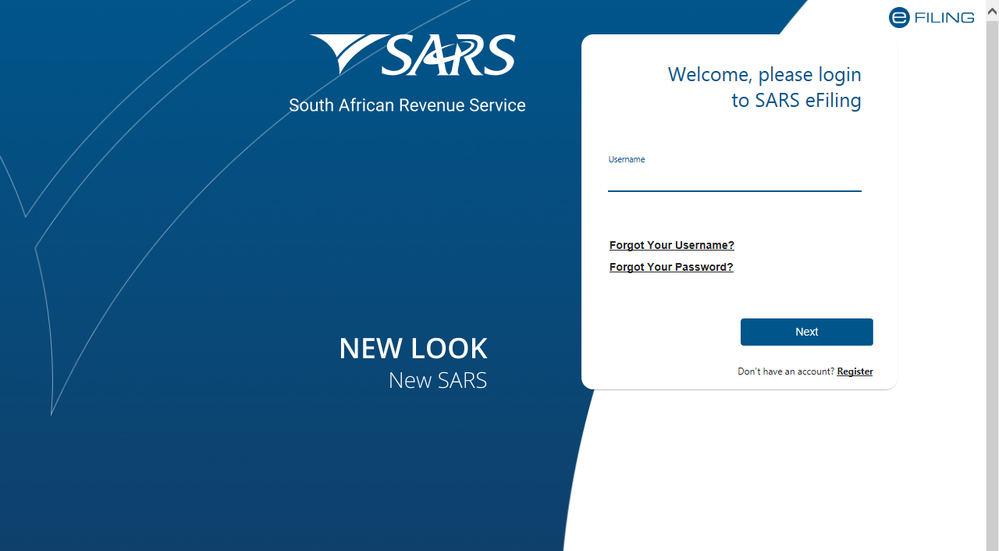
Registration, Licensing and Accreditation (RLA)
How to register for eFILING
Once the client has been registered with SARS, the client can then register for eFiling if not already an eFiler. This can be done by logging onto the SARS website
Notes:
Based on this slide, which is a brief synopsis of the first three phases for implementation, some of the deliverables are:
RLA: Electronic application, Automated Case Management, Approvals for Entity Associations and Approval of Bonds.
RCG: Reporting of Cargo, Outturn Reporting and Goods Accounting.
DPS: The implementation of the new Clearance Procedures, Customs Procedure Codes and Customs Procedures.

Slide 13
New Customs Acts Programme (NCAP)
RLA Registration via eFiling

Slide 14
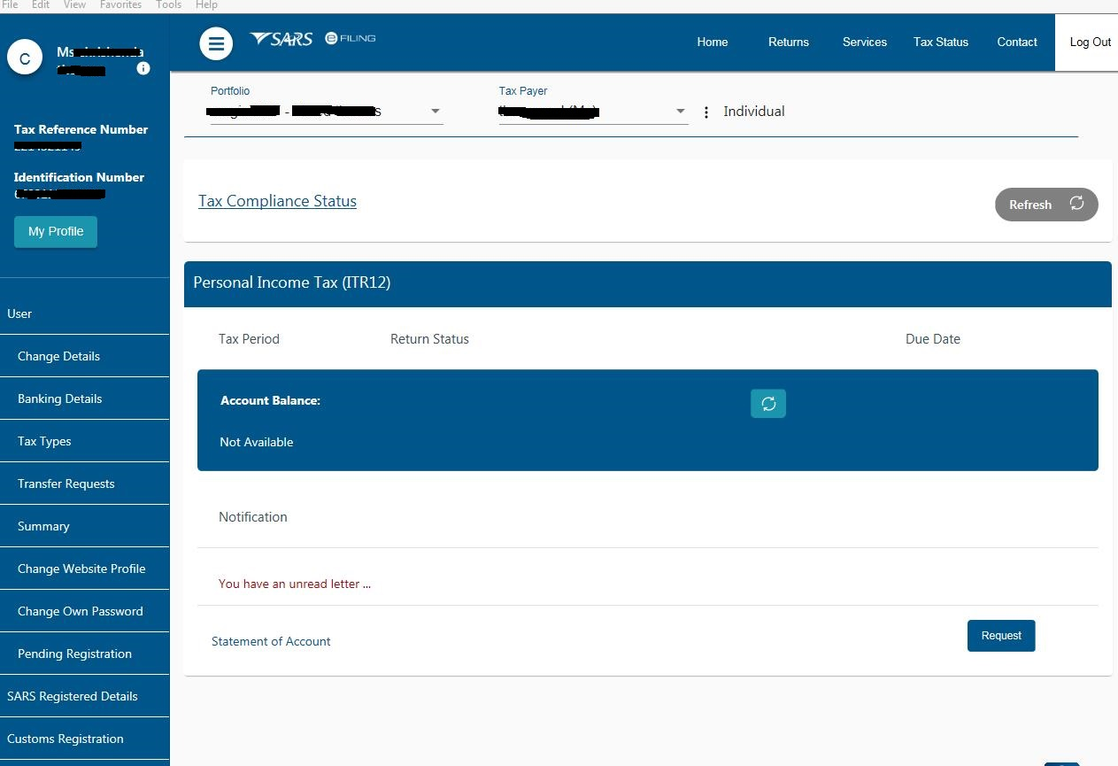
Registration, Licensing and Accreditation (RLA)
Changing your eFiling profile from Individual to Organisation
Click “Home” on top menu. Then “User” on left menu, then “Change Website Profile”

Slide 15
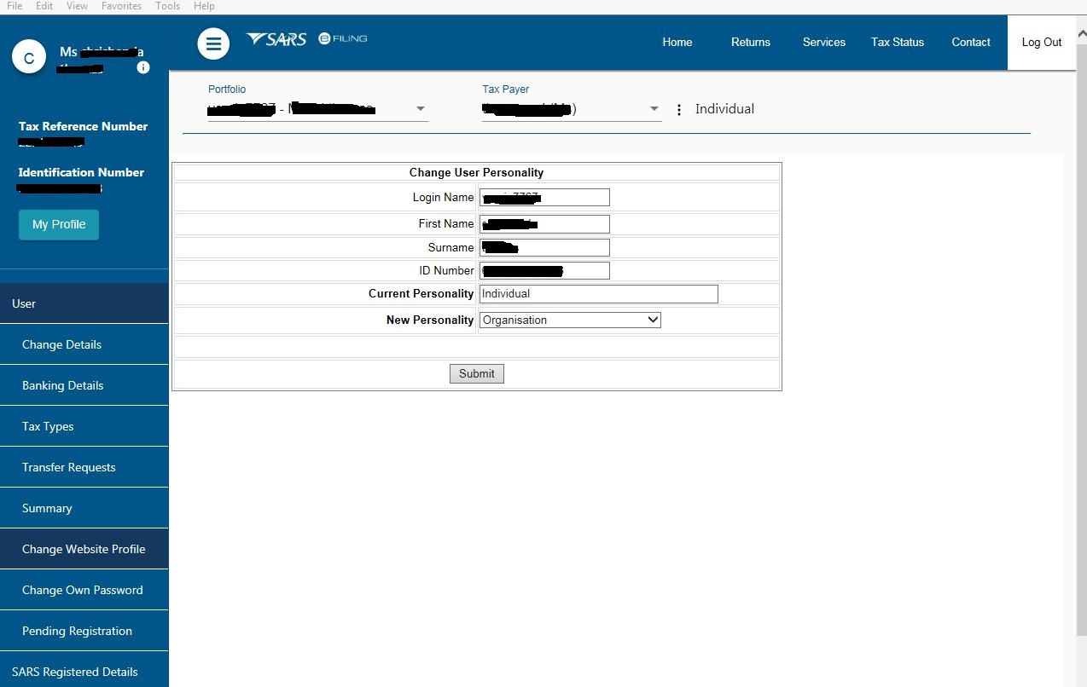
Registration, Licensing and Accreditation (RLA)
Changing your eFiling profile from Individual to Organisation

Slide 16
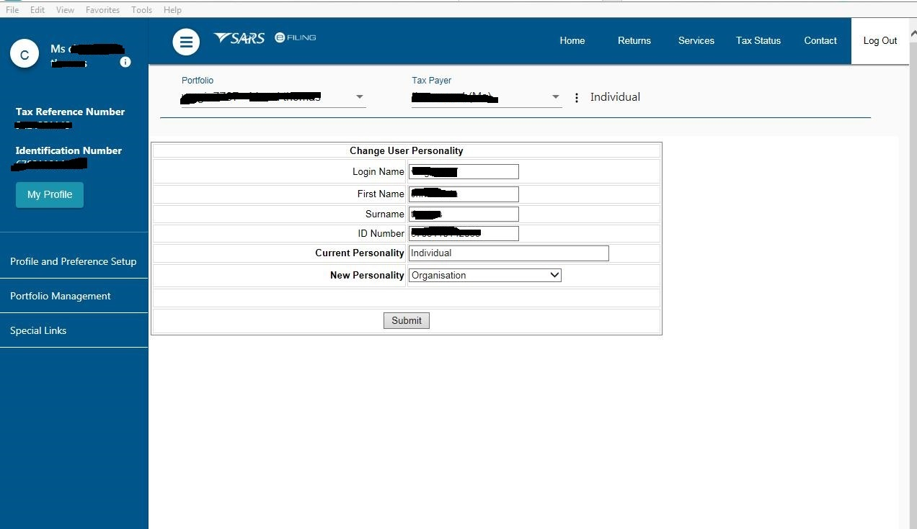
Registration, Licensing and Accreditation (RLA)
Changing your eFiling profile from Individual to Organisation
Click “My Profile”, then “Portfolio Management”

Slide 17
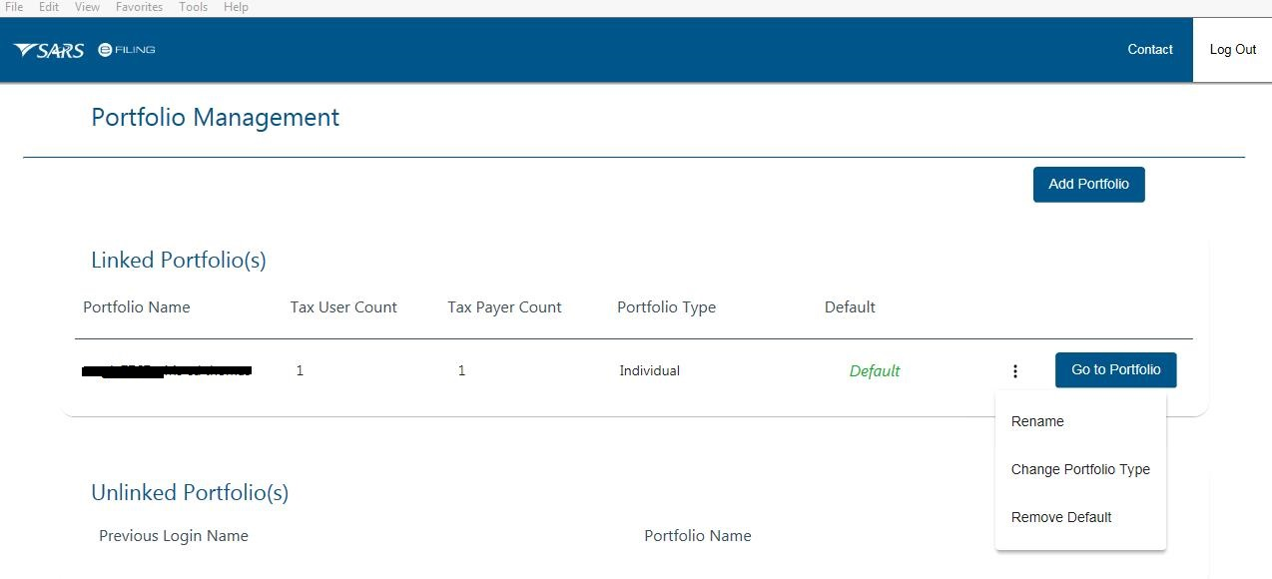
Registration, Licensing and Accreditation (RLA)
Changing your eFiling profile from individual to Organisation
Click on the 3 dots, select “Change Portfolio Type”, change it to “Organisation” and save

Slide 18
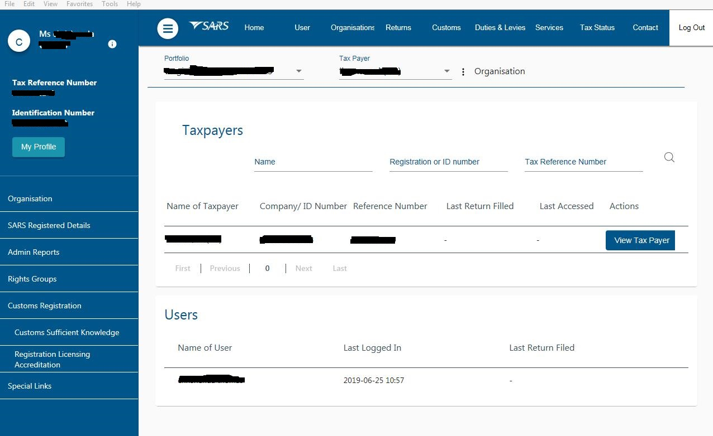
Registration, Licensing and Accreditation (RLA)
Changing your eFiling profile from Individual to Organisation
“Organisation” and “Customs” is now available in the top menu. Click “Customs Registration” on the left menu bar, then “Registration Licensing Accreditation” to launch RLA

Slide 19
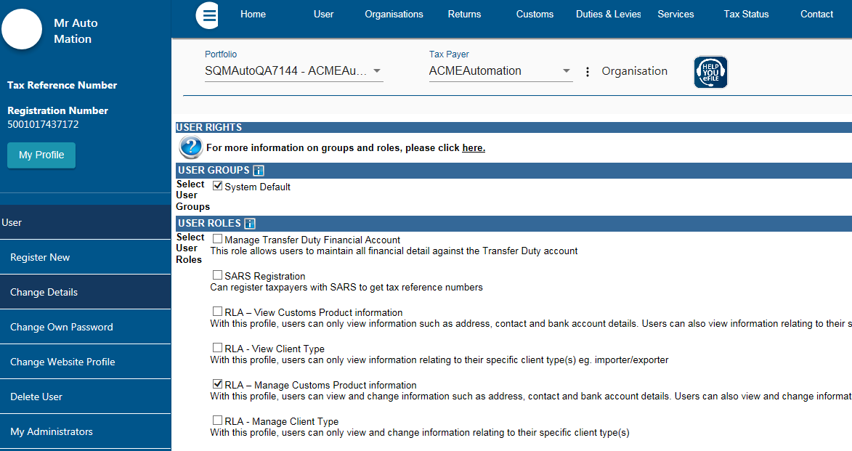
Registration, Licensing and Accreditation (RLA)
Role allocation on eFiling
Click on “User” on the top menu bar, then “User” on the left menu bar, then “Change Details” in order to make a role selection.

Slide 20
Registration, Licensing and Accreditation (RLA)
Role allocation on eFiling
Once registered on eFiling, the user will need to ensure that roles were allocated correctly, in order to apply via RLA. This can be done via your internal eFiling administrator.
The user will be allowed to select only ONE of the following user roles:
  RLA View Customs Product
  RLA View Client Type
  RLA Manage Customs Product (This role allows full submission rights)
  RLA Manage Client Type
Please note the description of each of the roles, as not all roles allow submission of applications on RLA:
  RLA View role – only view access and no submission capabilities;
  RLA Manage role allows submission capabilities.

Slide 21
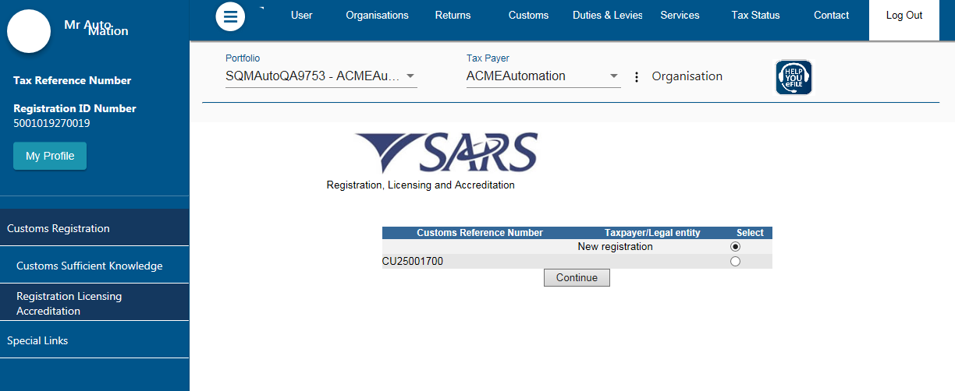
Registration, Licensing and Accreditation (RLA)
Accessing RLA
Once the role allocation has been finalised, the user can then click through to submit an application via RLA by selecting the “Customs” tab and thereafter selecting “Registration Licensing Accreditation” from the menu on the left
Once on this screen:
Existing Trader – select the displayed Customs Code;
New Trader – select new registration option;
NB – if you are an existing trader, the new registration option will not be displayed.

Slide 22
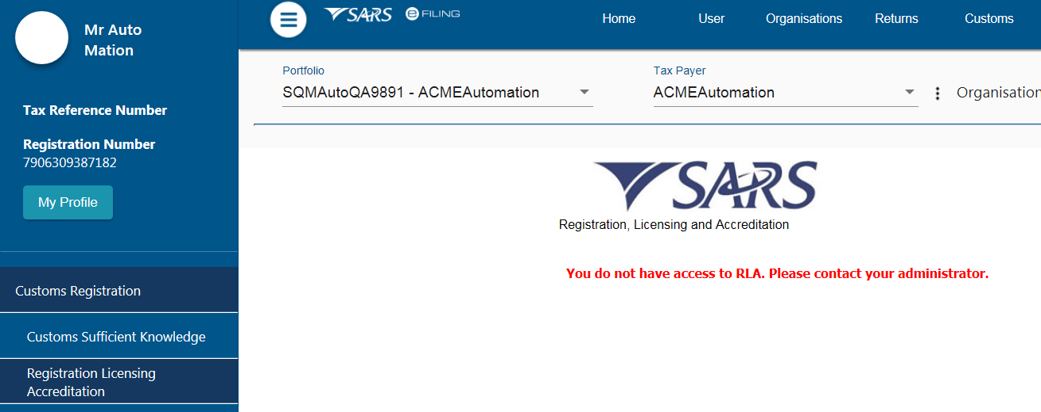
Registration, Licensing and Accreditation (RLA)
Accessing RLA
If you receive this message: ”You do not have access to RLA…” , this implies that your user roles have not been set up correctly. You will need to contact your internal eFiling system administrator to grant you the necessary RLA user role.

Slide 23
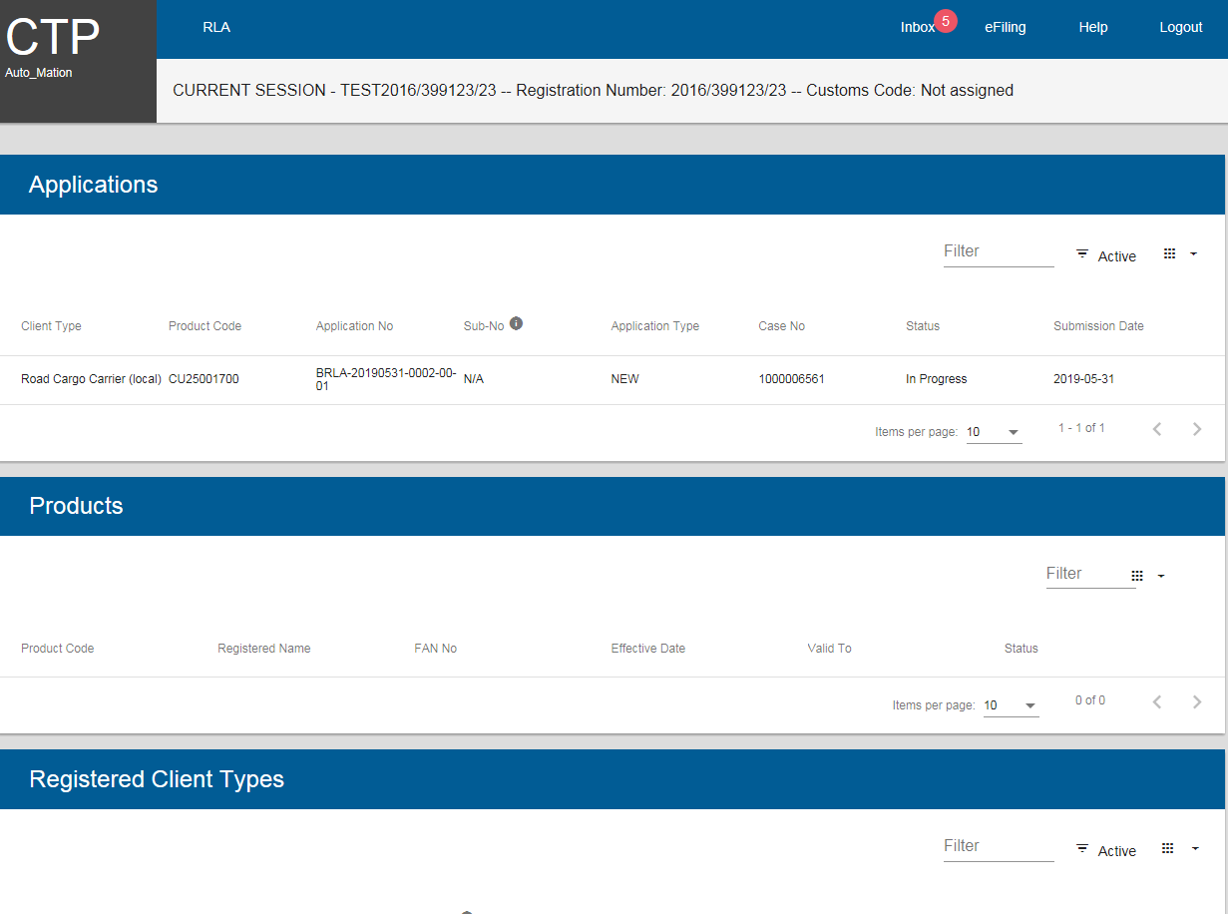
Registration, Licensing and Accreditation (RLA)
Registration for RLA via eFiling
Once the client has selected “Registration, Licensing and Accreditation” from the eFiling menu, the client will be presented with the Customs Trader Portal (CTP) dashboard, which on first access will be blank

Slide 24
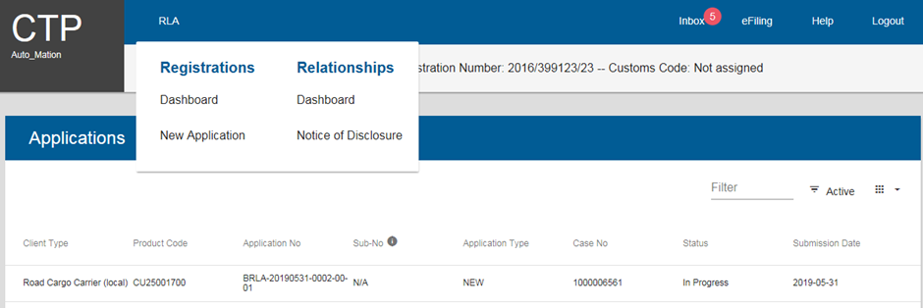
Registration, Licensing and Accreditation (RLA)
Registration for RLA via eFiling
From the dashboard, the client will click on “RLA” and select “New Application” from the pop up.
Once the first application is submitted, the client will be unable to make any additional applications until the first submitted application has been finalised.
The outcome of the application can be viewed from the Dashboard “Inbox”

Slide 25
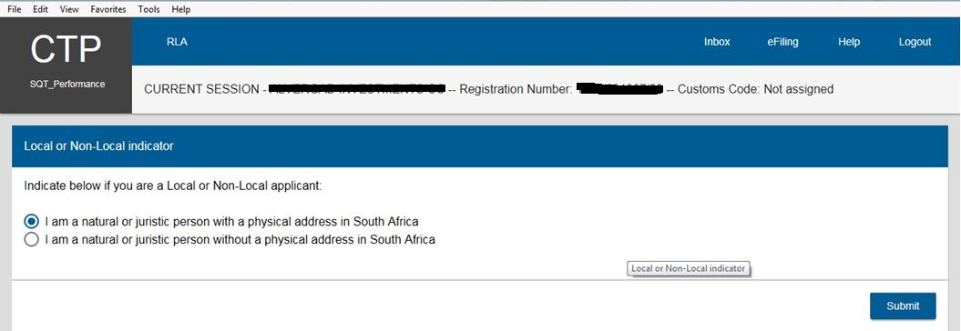
Registration, Licensing and Accreditation (RLA)
Registration for RLA via eFiling
Once a “new application” is initiated, the client will be presented with the question about being “local” or “non-local”. This question will only be asked on the first application.

Slide 26
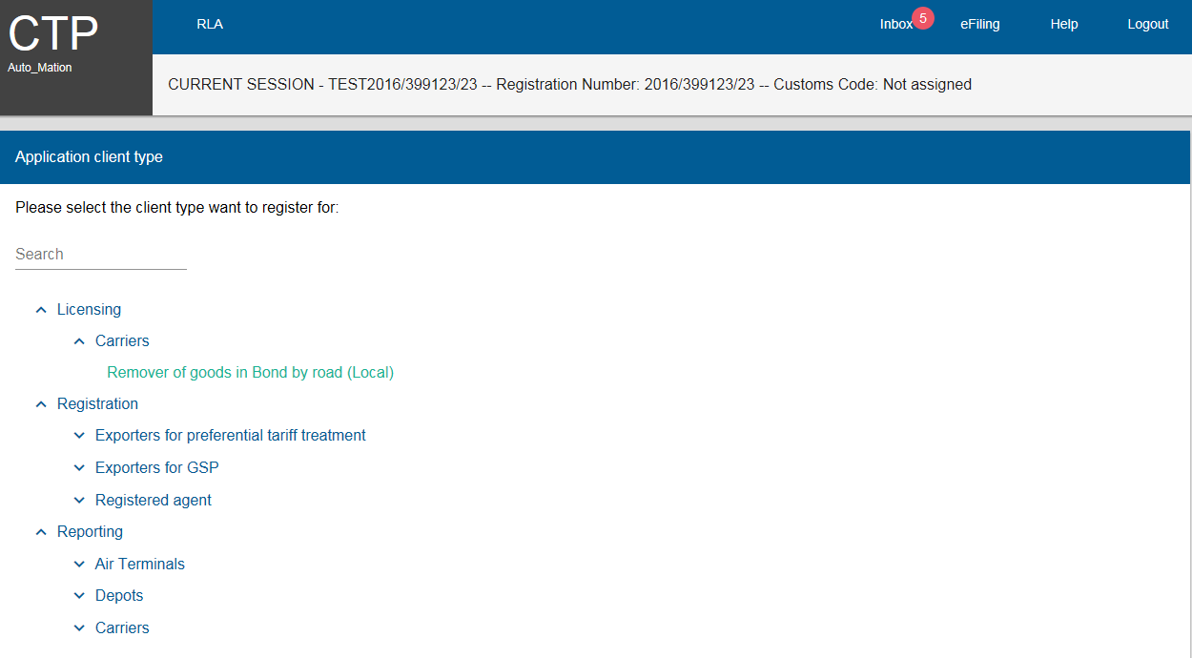
Registration, Licensing and Accreditation (RLA)
Registration for RLA via eFiling
The client will then be presented with three categories of applications: Licensing, Registration and Reporting
The client can then choose the category and the associated client type.

Slide 27
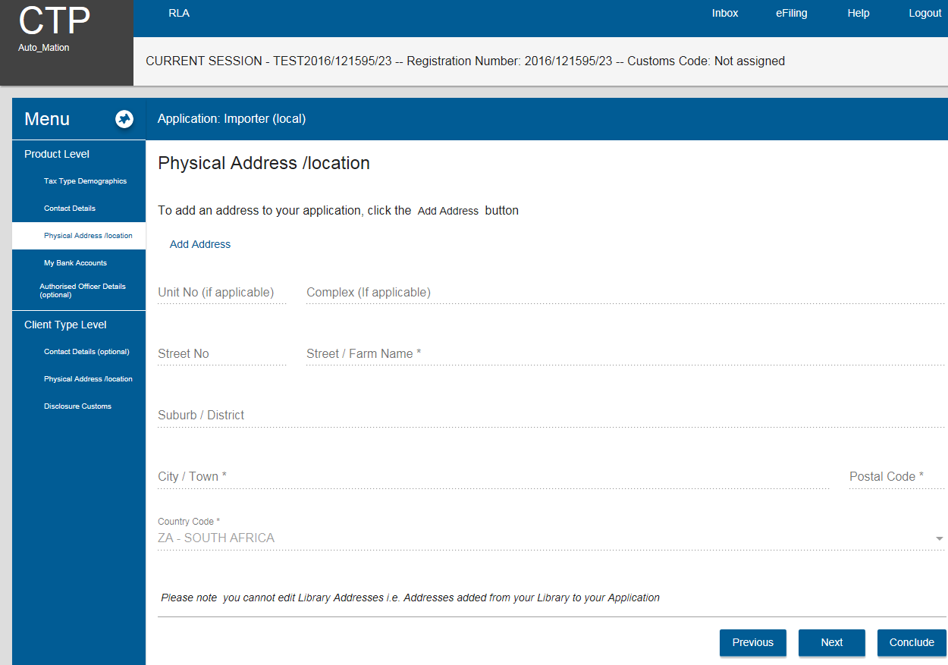
Registration, Licensing and Accreditation (RLA)
Registration for RLA via eFiling
The client will then be presented with different screens for the submission of application-related information e.g. address, contact details

Slide 28
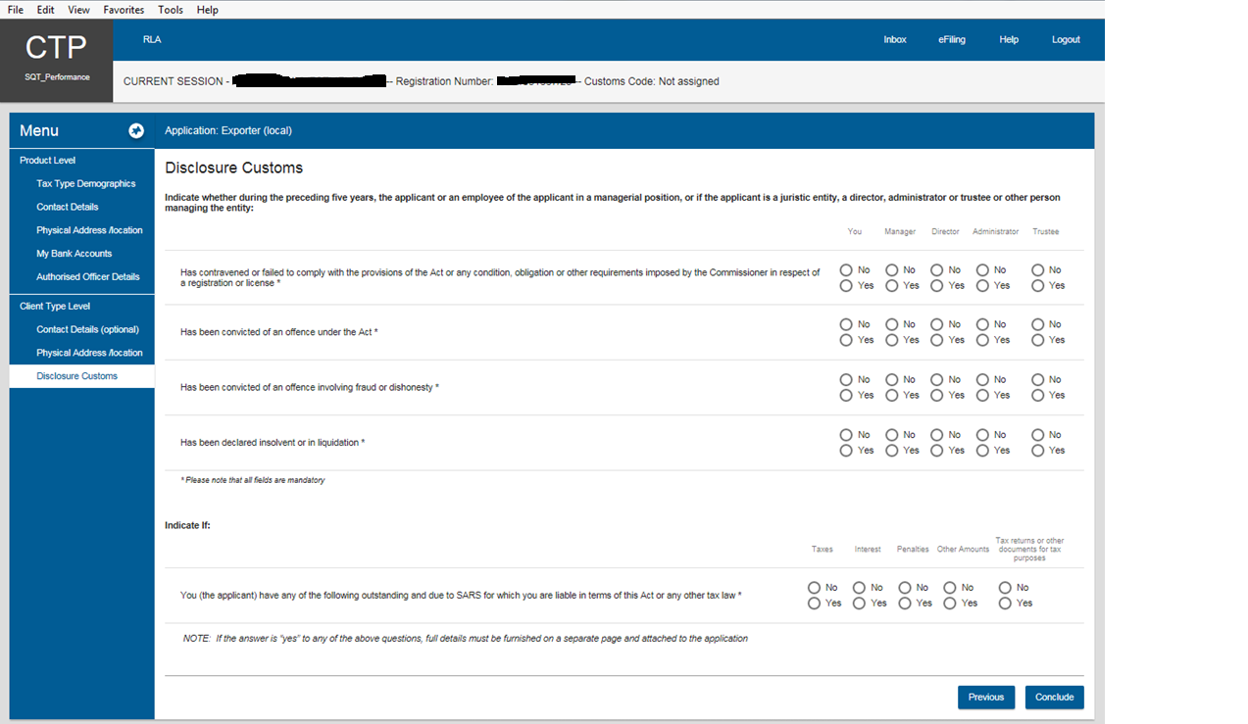
Registration, Licensing and Accreditation (RLA)
Registration for RLA via eFiling
The information needed to be declared for the application is concluded with the “Disclosure Customs” screen which includes question on your liabilities to SARS, offences, etc.

Slide 29
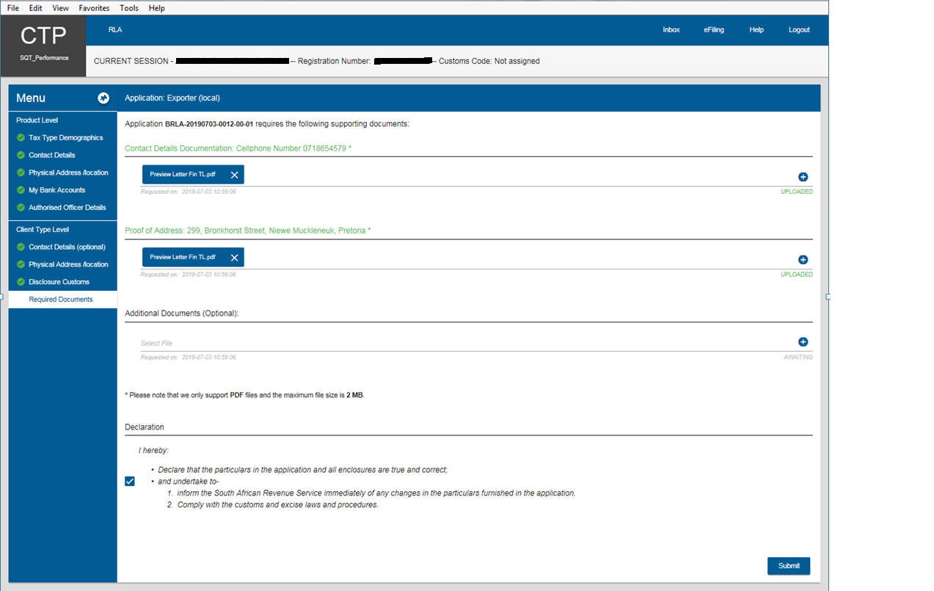
Registration, Licensing and Accreditation (RLA)
Registration for RLA via eFiling
On clicking the “Conclude” button, the system will validate captured information prior to submission. Information that is captured completely and correctly will be indicated with a green tick (✓). Information that is missing or captured incorrectly will be indicated with a red cross (✗).

Slide 30
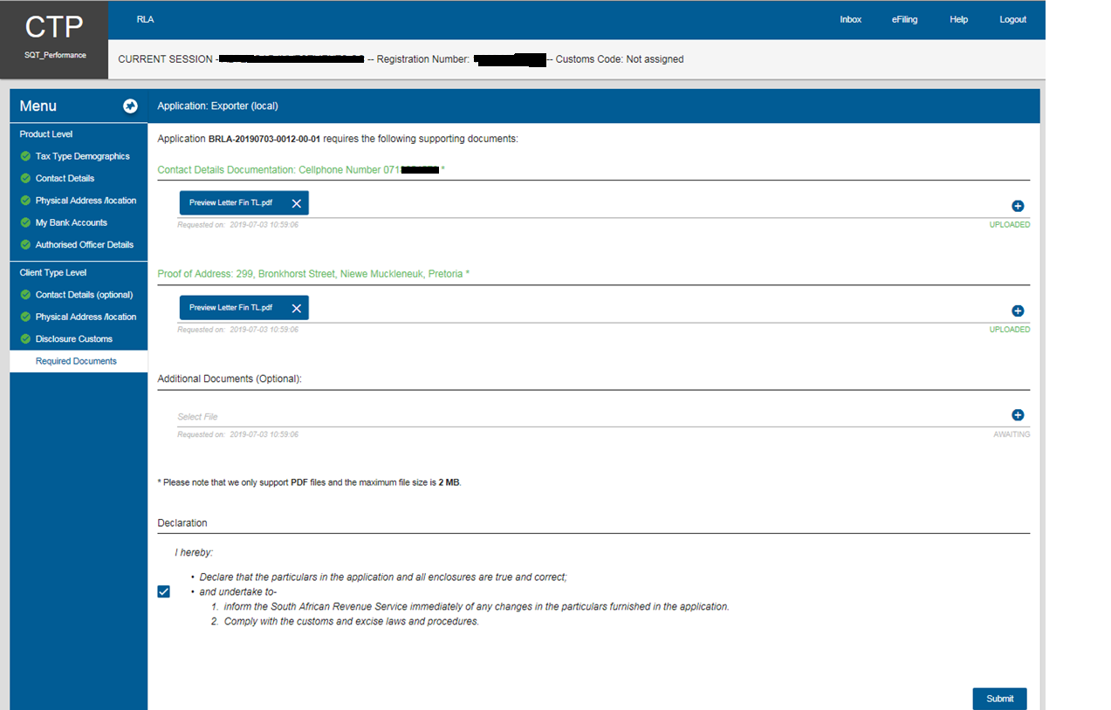
Registration, Licensing and Accreditation (RLA)
Registration for RLA via eFiling
The client will then be prompted by the system as to what supporting document(s) must be uploaded in order to finalise the application, e.g. proof of address etc.

Slide 31
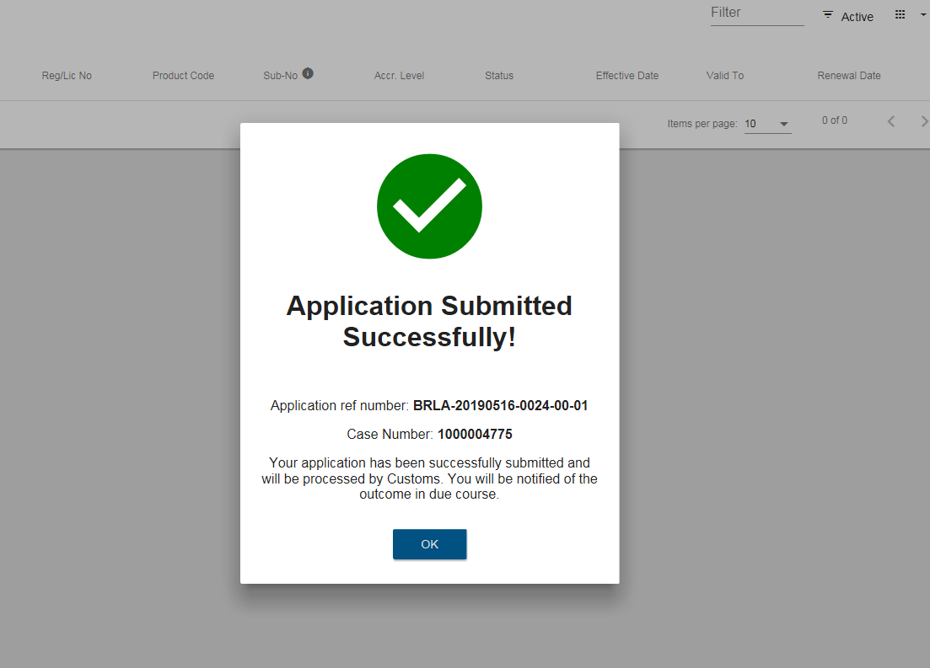
Registration, Licensing and Accreditation (RLA)
Registration for RLA via eFiling
Upon submission, the client will receive confirmation of submission, including application reference and case number. These reference numbers can be used to view their application status on the Dashboard or enquire with SARS.

Slide 32
New Customs Acts Programme (NCAP)
RLA Registration via BFE

Slide 33
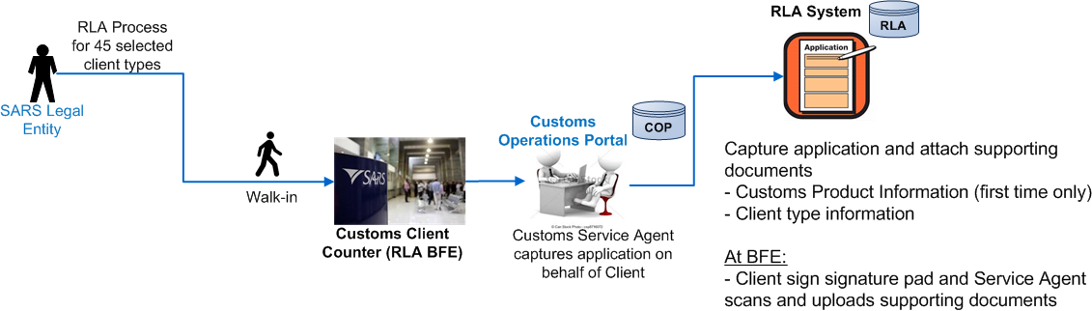
Registration, Licensing and Accreditation (RLA)
Registration for RLA via BFE

Slide 34
RLA registration via the BFE process
Registration, Licensing and Accreditation (RLA)
If a client chooses to register via BFE, the following will apply:
After authentication of the client, a Customs official will capture the application in the presence of the client;
Non-locals can be registered via a local representative with the necessary authority;
Details captured will cover Tax Type Demographics; contact details; banking details; disclosure;
In the event of sensitive information (bank info), the Team Leader will be requested to perform over-the-shoulder verification before the application can be submitted;
Before submitting the application, the system will indicate the necessary supporting documents required for this application;
The Customs Officer will scan the supporting documents to the case, using a scanning cover sheet;
On submission of the application, the client will have to sign on the signature pad confirming that the info captured is correct;
The client will then receive a hard copy letter indicating the case reference number and application reference number from the SARS official;
This is also available on the client’s dashboard.
Please note that your queuing time at the branch office may be extended due to the application capture process and uploading of supporting documents

Slide 35
Non-locals: Channels for applications for RLA
Registration, Licensing and Accreditation (RLA)
For non-locals, if they are registered with SARS and have an activated eFiling profile, they will be allowed to submit applications online;
Non-locals who are not registered with SARS or do not have an activated eFiling profile:
  Will have to present themselves at the SARS Branch in order for the entity and product to be registered. Thereafter, an eFiling profile may be created and activated by the Trader;
  If the non-local is unable to present themselves at the Branch, they can submit such an application for the entity and product to be registered via a SA “representative”. Thereafter an eFiling profile may be created and activated by the Trader.
Non-locals must declare a local bank account (Own account or third party bank account)

Slide 36
New Customs Acts Programme (NCAP)
Relationship Management

Slide 37
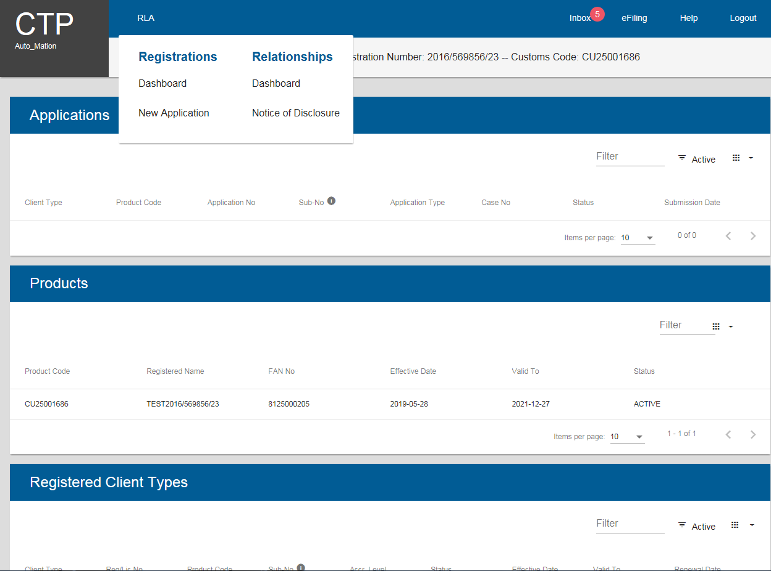
Relationship Management Module
Registration, Licensing and Accreditation (RLA)
In order to disclose a relationship, the client will have to initiate this via the dashboard

Slide 38
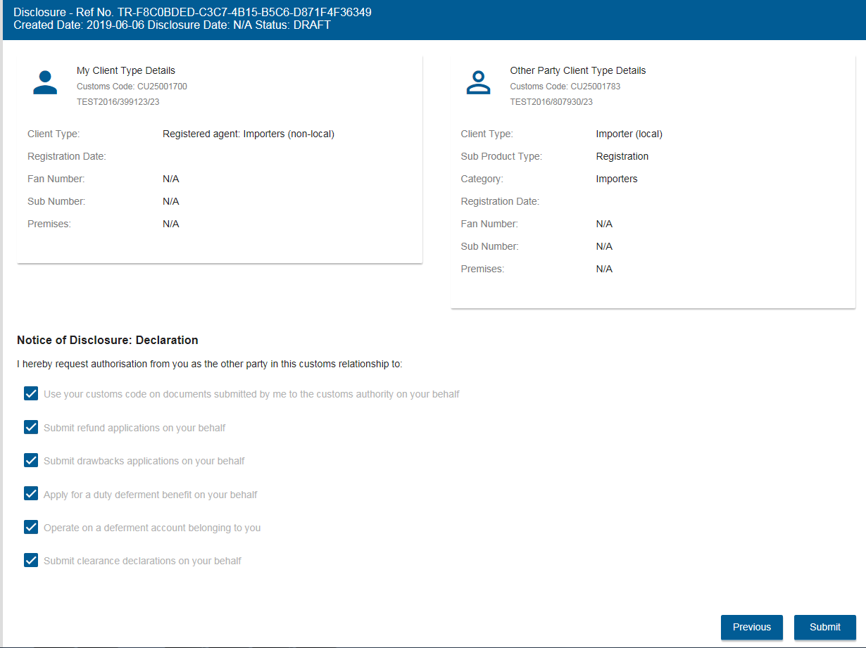
Relationship Management Module
Registration, Licensing and Accreditation (RLA)
The client will disclose other party details for the relationship to be initiated. Depending on client types, you may also authorise the transactional level activity e.g. submit refund applications

Slide 39
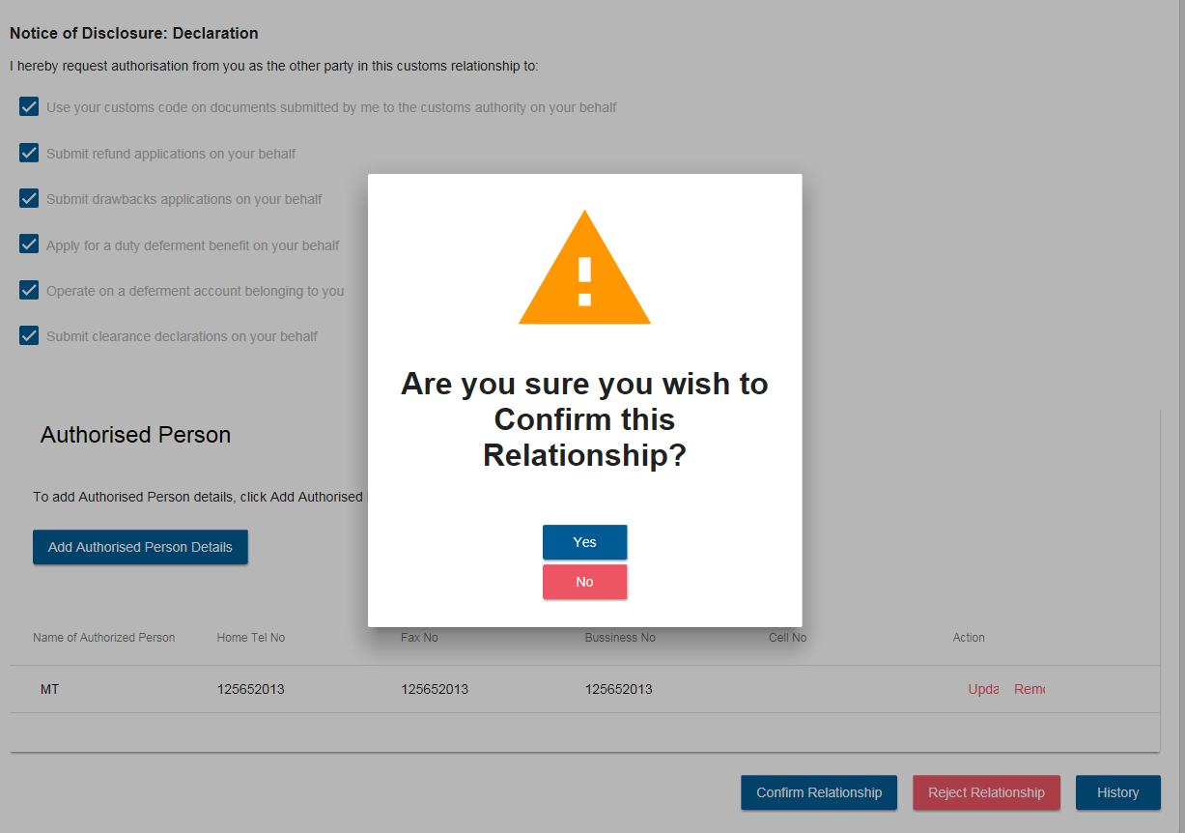
Relationship Management Module
Registration, Licensing and Accreditation (RLA)
No relationship will be registered on the system if the nominee does not confirm or action the disclosure

Slide 40
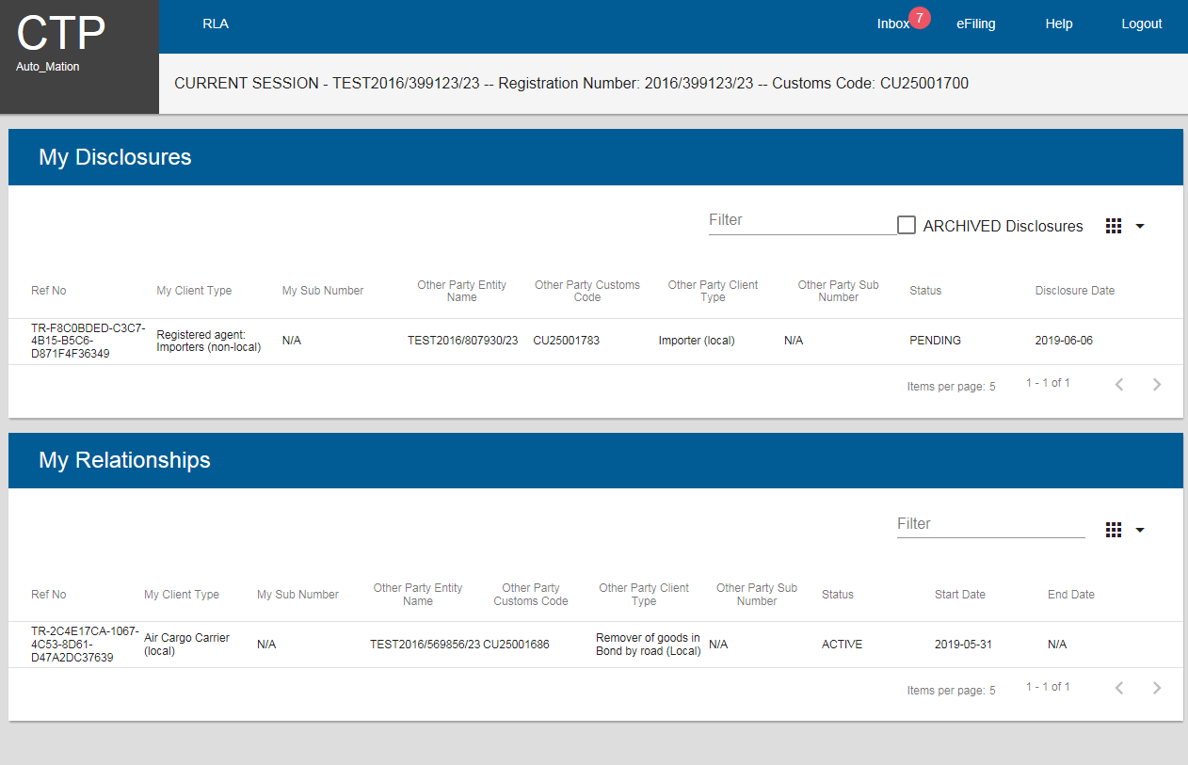
Relationship Management Module
Registration, Licensing and Accreditation (RLA)
Relationships disclosed will be updated on the Dashboard which both parties have sight of

Slide 41
New Customs Acts Programme (NCAP)
eFiling vs Branch Submission

Slide 42
Registration, Licensing and Accreditation (RLA)
Submission via eFiling:
There is no need to come into an office and queue for application submissions;
The system indicates documents required at time of submission;
You are able to electronically view your profile and submission status via the CTP dashboard;
You are able to electronically upload required documents;
Notifications received from Customs can be viewed via the dashboard;
Correspondence will be managed via SMS / email notifications;
You will be able to save draft applications and return to them at a later stage in case you do not have all the necessary information;
Disclosure and subsequent management of relationships will be done electronically;
You will have access to your information via the dashboard at any time.
Will be able to save an application in draft prior to submission but this must be submitted to Customs for processing with in 7 days, or else the system will auto- abandon the drafted application

Slide 43
Registration, Licensing and Accreditation (RLA)
Submission via Branch:
You will need to come into the Customs branch to submit a hard copy application and supporting documents;
There could be extended queuing time as the application has to be captured by a Service Agent;
Upon completion, you will have to take back all hard copy documents to your office;
If you have forgotten necessary information/documentation, you will have to return to the branch to complete the application;
You will have to come back to the branch to access any communication submitted to your dashboard;
You will have to return to the branch to:
  access your dashboard to view your profile;
  disclose your relationships;
  accept relationships disclosed with you;
  cancel any relationships no longer required.
Access to your information via the dashboard is during operational hours only.
Applications can not be saved @ BFE – must be presented withy full and complete information in order to submit application for registration

Slide 44
New Customs Acts Programme (NCAP)
Anticipated impact on Trade

Slide 45
Parallel processing of RLA and RAS / DA8
Registration, Licensing and Accreditation (RLA)
RLA Process and the Current Process
During Release 1 of RLA, the above stated 45 client types will be required to register/license electronically via e-Filing or at a Customs branch on the new RLA system.
The remaining client types will be required to follow the current process of registration/licensing for Release 1 of RLA by visiting the customs branch office of which the current RAS system and RAV01 / DA8 form will be used.

Slide 46
Registration, Licensing and Accreditation (RLA)
Anticipated impact on Trade
Based on the “RLA Process overview”, the following will impact Trade:
Dual application channels – the process allows for clients to make submissions either via the RLA system (eFiling or BFE) for predefined client types or via the current manual process for other client types;
Clients that wish to submit applications at BFE using a representative (driver / runner) must ensure that he/she has a mandate duly authorising such action and will need to all information to be successfully submitted.
  Such representative will be authenticated and may need to perform a legal entity registration
Longer queuing time may occur for BFE applications;
Meeting / scheduled application submission times as deemed necessary by Branch Management to be arranged;
Legal Entity Registration (LER) / authentication @ BFE will be required;
The service agent will have to capture applications on behalf of the Trader on RLA instead of the Trader merely handing in the application form as before;
Traders will have to undertake eFiling activation and organisational role assignment for application management, including RMM

Slide 47
Registration, Licensing and Accreditation (RLA)
Anticipated impact on Trade
Based on the “RLA Process overview”, the following will impact Trade (cont…):
Renewal of licenses as per Schedule 8 to continue as is (submit DA185) even though the initial client type application was processed via RLA;
Non-locals – must have an SA Bank account / 3rd party SA Bank Account to declare.
Turn around time (TAT) – as this is a new system, processing time has not been established. TAT and compliance to the SARS Service Charter will be assessed after implementation;
First time application on RLA – the first application must be finalised by SARS before the 2nd and subsequent applications can be submitted, in parallel if so required;
Existing clients need not re-register as their status will be maintained by SARS Customs, but may at a later stage be called on by Operations to renew their information via RLA;
  If a new client type is required and is part of the 45 client types in Release 1, the client will then have to submit complete trader information application on RLA;
Supporting documents must be upload per requested document type e.g. address in a PDF format (2mb per file, maximum 10mb per case)

Slide 48
Trade Support

Slide 49

Registration, Licensing and Accreditation (RLA)
Communications
After the roadshows, we will communicate about RLA via the following channels:
SARS website (www.sars.gov.za>Customs&Excise>NewCustoms Legislation Update>RLA). The RLA site should be live the week after the last roadshow. It will include consolidated FAQs and presentations from the roadshows
Social media. On Facebook and Linked In, follow South African Revenue Service and on Twitter, follow @sarstax. Updates on RLA before and during the rollout will be published here
Email letters (sent via umbrella organisations and Customs branch managers)
Dedicated NCAP mailbox for queries: NewCustomsActs@sars.gov.za
Support during go-live
To support you during the go-live, there will also be user guides and tutorial videos published on the SARS website

Slide 50
Registration, Licensing and Accreditation (RLA)
Stakeholder Management
During implementation and post implementation, the following staff members will be available to assist when and where needed:
Private Sector:
Claudette Davis
Email: CDavis2@sars.gov.za
Landline: 012 647 9785
Public Sector:
Eureka Ramphal
Email: ERamphal@sars.gov.za
Landline: 012 422 4453

Slide 52
Backup slides

Slide 53
New Customs Acts Programme (NCAP)
1964 Act client types for September 2019 release initiated from RLA
 | Client Type |  | Client Type |  | Client Type |  | Client Type
1 | Transit Shed Operator | 12 | Own Goods Carrier: Air Cargo | 23 | Exporter for SADC (local) | 34 | Exporter for GSP - Norway (local)
2 | De-grouping Depot Operator | 13 | Own Goods Carrier: Rail Cargo | 24 | Exporter for SADC-EPA (local) | 35 | Exporter for GSP - Russia (local)
3 | Container Depot | 14 | Own Goods Carrier: Road Cargo | 25 | Exporter for - SACU/EFTA (local) | 36 | Exporter for GSP - Turkey (local)
4 | Air Cargo Carrier (local) | 15 | Own Goods Carrier: Sea Cargo | 26 | Exporter - SADC (non-local) | 37 | Exporter GSP - AGOA (non-local)
5 | Air Cargo Carrier (non-local) | 16 | Sea Carrier (local) | 27 | Exporter - SADC EPA (non-local) | 38 | Exporter GSP - Norway (non-local)
6 | Rail Cargo Carrier (local) | 17 | Sea Carrier (non-local) | 28 | Exporter for - SACU/EFTA (non-local) | 39 | Exporter GSP - Russia (non-local)
7 | Rail Cargo Carrier (non-local) | 18 | Clearing Agent | 29 | Approved Exporter - SADC EPA (local) | 40 | Exporter GSP - Turkey (non-local)
8 | Remover of goods in Bond by road (Local) | 19 | Importer (local) | 30 | Approved Exporter - SACU/EFTA (local) | 41 | Registered agent: Importers (non-local)
9 | Remover of goods in Bond by road (non-local) | 20 | Importer (non-local) | 31 | Approved Exporter - SADC EPA (Non-local) | 42 | Registered agent: Exporters (non-local)
10 | Road Cargo Carrier (local) | 21 | Exporter (local) | 32 | Approved Exporter - SACU/EFTA (non-local) | 43 | Registered agent: Carriers (non-local)
11 | Road Cargo Carrier (non-local) | 22 | Exporter (non-local) | 33 | Exporter for GSP - AGOA (local) | 44 | Exporter for - SACU/MERCOSUR (local)
 |  |  |  |  |  | 45 | Exporter for - SACU/MERCOSUR (non-Local)

Slide 54
New Customs Acts Programme (NCAP)
1964 Act client types for September 2019 release initiated from DA185 / DA8
 | Client Type |  | Client Type
1 | Rebate users | 14 | Electronic user (EDI)
2 | Storage Warehouse (OS) | 15 | Registered Agent: Air Carrier (Non-local)
3 | Special or Ordinary Storage Warehouse (SOS / OS) | 16 | Registered Agent: Sea Carrier (Non-local)
4 | Inbound Duty and Tax Free Shop | 17 | Registered Agent: Road Carrier (Non-local)
5 | Outbound Duty and Tax Free Shop | 18 | Registered Agent: Rail Carrier (Non-local)
6 | SOS Storage warehouse | 19 | Clearing Agent: Air
7 | Producer ito - TDCA | 20 | Clearing Agent: Sea
8 | Producer ito - SADC | 21 | Port Authority: Air
9 | Producer ito - SACU/EFTA | 22 | Port Authority: Sea
10 | Producer ito GSP- Norway | 23 | Railway Authority
11 | Producer ito GSP- Russia | 24 | Container Terminal Operator
12 | Manufacturer AGOA | 25 | Wharf Operator
13 | Producer ito GSP- Turkey

Slide 55
New Customs Acts Programme (NCAP)
1964 Act client types for June 2020 Release 2b initiated from RLA
 | Client Type |  | Client Type |  | Client Type |  | Client Type
1 | Storage Warehouse (OS) - Imported Goods | 12 | Rebate User | 23 | Electronic user - EDI Carrier Cargo Reporter (Local) | 34 | Registered Agent: Air Carrier (Non-local)
2 | Storage Warehouse (OS)- Imported Goods - Stockist | 13 | Producer ito - SADC EPA | 24 | Electronic user - EDI Depot Cargo Reporter (Local) | 35 | Registered Agent: Sea Carrier (Non-local)
3 | Special Storage Warehouse (SOS) - Dutiable Imported Goods | 14 | Producer ito - SADC | 25 | Electronic user - EDI Terminal / Transit Shed Cargo Reporter (Local) | 36 | Registered Agent: Road Carrier (Non-local)
4 | Special Storage Warehouse (SOS) - Duty free Imported Goods for Export (Sec 21.3) | 15 | Producer ito - SACU - MERCOSUR | 26 | Electronic user - EDI Clearing Agent Cargo Reporter (Local) | 37 | Registered Agent: Rail Carrier (Non-local)
5 | Special Storage Warehouse (SOS) - Dutiable locally manufactured goods for Export | 16 | Producer ito - SACU/EFTA | 27 | Electronic user - EDI Registered Agent Carrier Cargo Reporter (Local) | 38 | Clearing Agent: Air
6 | Special Storage Warehouse (SOS) - Inbound duty and tax free shop | 17 | Producer ito GSP- Norway | 28 | Electronic user - EDI Carrier Cargo Reporter (Non - Local) | 39 | Clearing Agent: Sea
7 | Special Storage Warehouse (SOS)- Outbound duty and tax free shop | 18 | Producer ito GSP- Russia | 29 | Container depot | 40 | Port Authority: Air
8 | Special Storage Warehouse (SOS) - Inbound and Outbound duty and tax free shop | 19 | Producer ito GSP- Turkey | 30 | Degrouping depot | 41 | Port Authority: Sea
9 | Special Storage Warehouse (SOS) - Supply Ship/Aircraft stores | 20 | Manufacturer - AGOA | 31 | Searcher for or of a wreck (Local) | 42 | Railway Authority
10 | Special Storage Warehouse (SOS) -Supply Duty and Tax free shops and Ship/Aircraft stores | 21 | Electronic user - EDI Clearer Deferment Transactions (Local) | 32 | Searcher for or of a wreck (non-local) | 43 | Container Terminal Operator
11 | Storage Warehouse (OS) (CCA Enterprise) | 22 | Electronic user - EDI Release Authority (Local) | 33 | Registered agent: Searchers for or of a wreck (non-local) | 44 | Wharf Operator

